Slide 1
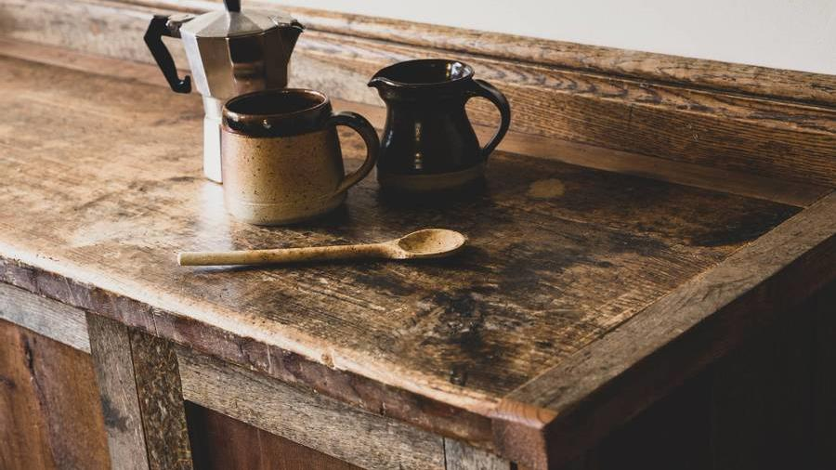
D’Coffee
Coffee Extraordinaire

Slide 2
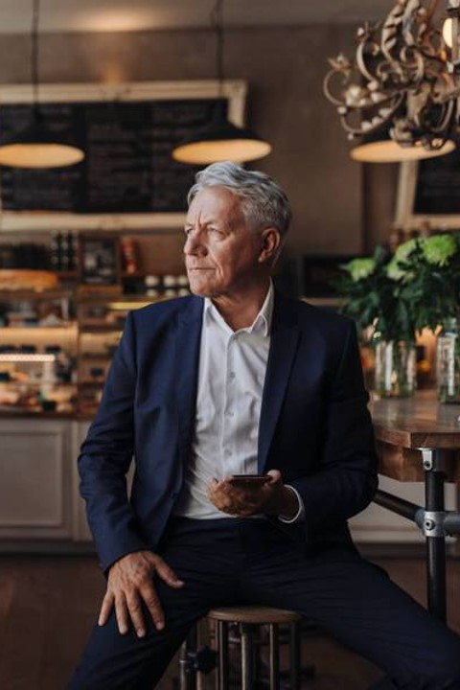


Introduction
Hey punks, its me john business!!!!
With your skills in HTML, CSS, Javascript, Bootstrap, Google Fonts and FontAwesome. I need you to help me…

Slide 3
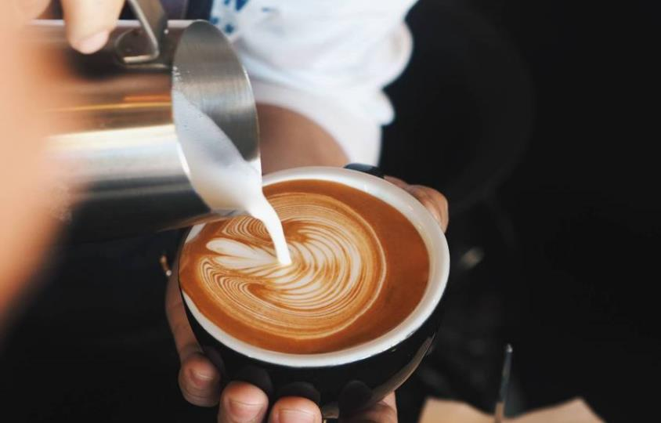

I need an ordering system building!
And you are going to do it!

Slide 4

What is required?
Order system for the following coffees:
Espresso
Americana (Black Coffee)
Latte
Cappuccino
Flat White
Macchiato
Mocha
Hot Chocolate
Including the following milk options:
Whole, Semi Skimmed, and Skimmed Milk
Oat Milk
Cashew Milk
Almond Milk
Soya Milk
Goat Milk
Yak Milk
Nettle Milk
Including the following flavour options:
Hazelnut
Caramel
Chocolate
Cinnamon
Peppermint
Vanilla
Salted Caramel
5 Spice
Truffle
Paprika
Turmeric
Lions Maine

Slide 5

Customisation is the key!
Customers must be able to customize their orders, to make the most unique flavours and taste combinations.
It is vital a customer can build their own combinations and make their special drinks!

Slide 6

Prices
Espresso Shot £1.50
Milks £2.00
Syrups £0.75
No more than 3 x syrups in an order
Only 2 milks in a half and half style

Slide 7
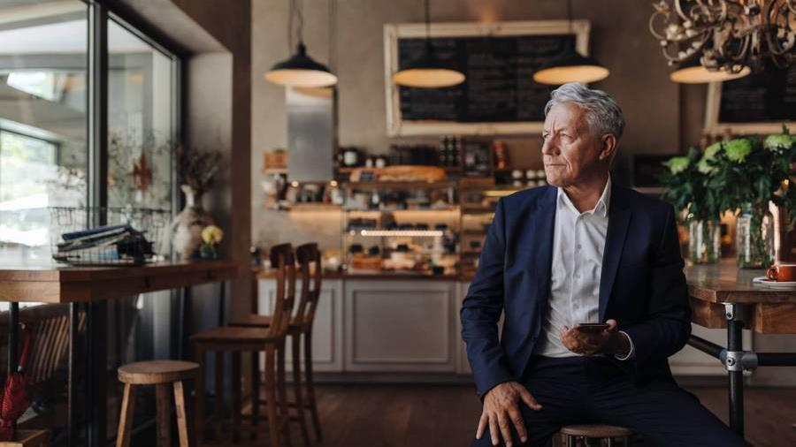

Thank you
#1 Thug ass gangsta

